Slide 1
Introduction of Software Testing

Slide 2
Learning Objectives :
Introduction of Software Testing.
Why is Testing necessary?
Participants in Testing
Best Practices in Testing
Skills required for Testing

Slide 3
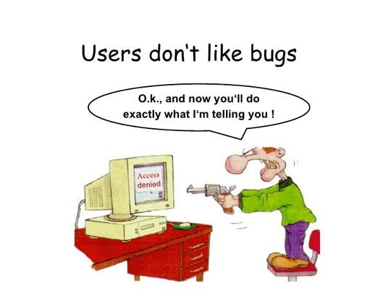
Software Testing

Slide 4
What is software testing
In Software Testing it is not sufficient to demonstrate that the software is doing what it is supposed to do.
In Software Testing it is more important to demonstrate that the software is not doing what it is not supposed to do.

Slide 5
Software testing can also be stated as the process of validating and verifying that a software program/application/product:
Works as expected according to the
business and technical requirements.
Works consistently and predictably.
Process of finding defects i.e. variance between Expected results and Actual results.
Process of executing a software program
application with intent of finding errors.

Slide 6
Why- What -How -Who
Why to test?
What to test?
How often to test?
Who tests?

Slide 7
Why is Testing necessary?
Software Testing is necessary to make sure the product or application is defect free, as per customer specifications.
Software Testing identifies faults whose removal increases the software quality and increases the software's reliability.
More complex the program, more the testing
effort is required.
Testing effort is directly proportional to the
complexity of the program.

Slide 8
Software should be:
Error Free
Efficient
Secured
Software Testing is important as it may cause mission failure, impact on operational performance and unreliable if not done properly

Slide 9
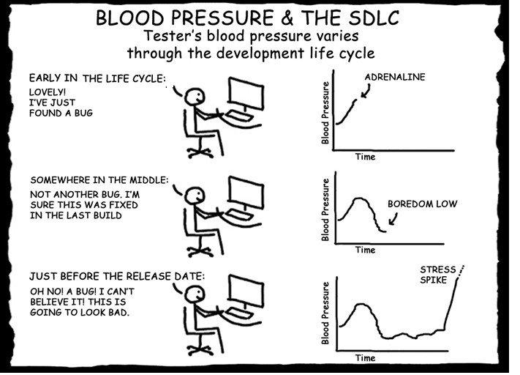
Star Testing When?

Slide 10
Stop Testing When?
Testing starts right from the requirements
phase and continues till the release time.
Objective of starting early:
Requirements related defects caught later in the SDLC result in higher cost to fix the defect.

Slide 11

Optimum Point
Quantity
Cost of Testing
Number of
defects
Under testing
Over Testing
D
uration
Duration

Slide 12
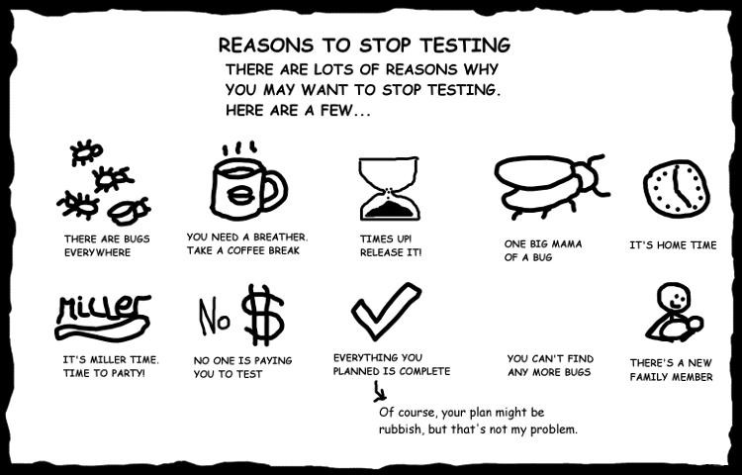
Stop testing When

Slide 13
Following factors are considered:
Test cases executed with acceptable percentage of defects
Project Deadlines e.g. release deadlines, testing deadlines
Test budget has run out.
Coverage of code, functionality or requirements reaches to specific point
Bug rate falls below acceptable level

Slide 14
Participants In Testing
Customer
User
Developer
Tester
Auditor

Slide 15
Common problems in the software development process
Poor Requirements – unclear, incomplete, too
general
Unrealistic Schedule – If too much work is
crammed in too little time, problems are inevitable.
Inadequate testing – No one will know whether or not the program is any good till the customer complains or system crashes.
Features –A request to pile on new features after
development is underway; extremely common.
Miscommunications – If developers don’t know what’s needed or customers have erroneous expectations, problems are guaranteed

Slide 16
Best Practices in Testing
Test Planning
Code Testability
Test often
Test early
Measure test costs, coverage, results and
effectiveness.
Negative Testing: Needs Kick the wall approach

Slide 17
Skill Required in Testing
Strong desire for quality and attention to detail.
Ability to understand the point of view of the
customer.
Tact and diplomacy for maintaining the cooperative
relationship with developers.
Ability to communicate with both technical and non- technical people.
Judgment skills are needed to assess high risk areas of an application on which to focus testing efforts when time is limited.
‘Test to break’ attitude.

Slide 18
Misconceptions
Anyone can test software: No particular skill is required.
Testers can test the quality at the end of the project!
Defects found means blaming to the
developers.

Slide 19
Interview Questions
What is Software Testing?
Justify the importance of Software testing.
What are the skills required for Testing?
What are the objectives of Early Testing?

Slide 20


